Slide 1
Python Full Stack Development
UNIVERSITY ADMISSION SYSTEM

Slide 2
TOPICS :
About our Project
Documentation(Literature review)
GitHub setup
Dataset collection and Tools setup
Work allocation to team members.

Slide 3
About Our Project
The project is regarding the “University Admission System” through which students can apply for different colleges/universities and different branches in online mode.
It will help the students to apply to the colleges in an easier and efficient way.
We use Django framework for the frontend.
We use MySQL for the backend .It is used to interact with the database.
After the student completes the admission process successfully ,the data is stored in a database and the roll number is generated immediately.

Slide 4
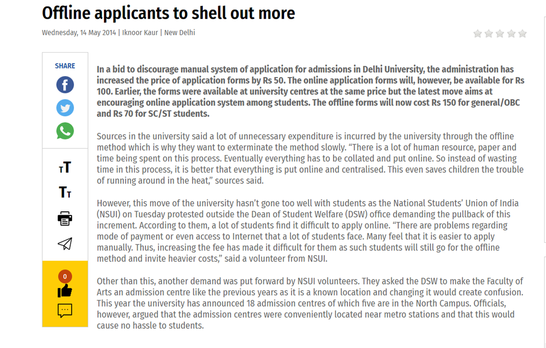
Documentation(Literature review)
Based on the mentioned surveys and reports it shows that if the admissions are to be done in offline mode then there are drawbacks mentioned as following:
First is that lot of unnecessary expenditure is incurred by the universities.
Secondly it requires lot of efforts both by the management and applicants.
When an applicant fills with wrong info then he/she isn’t notified resulting in wastage of the resources and time.
It is time consuming.

Slide 5
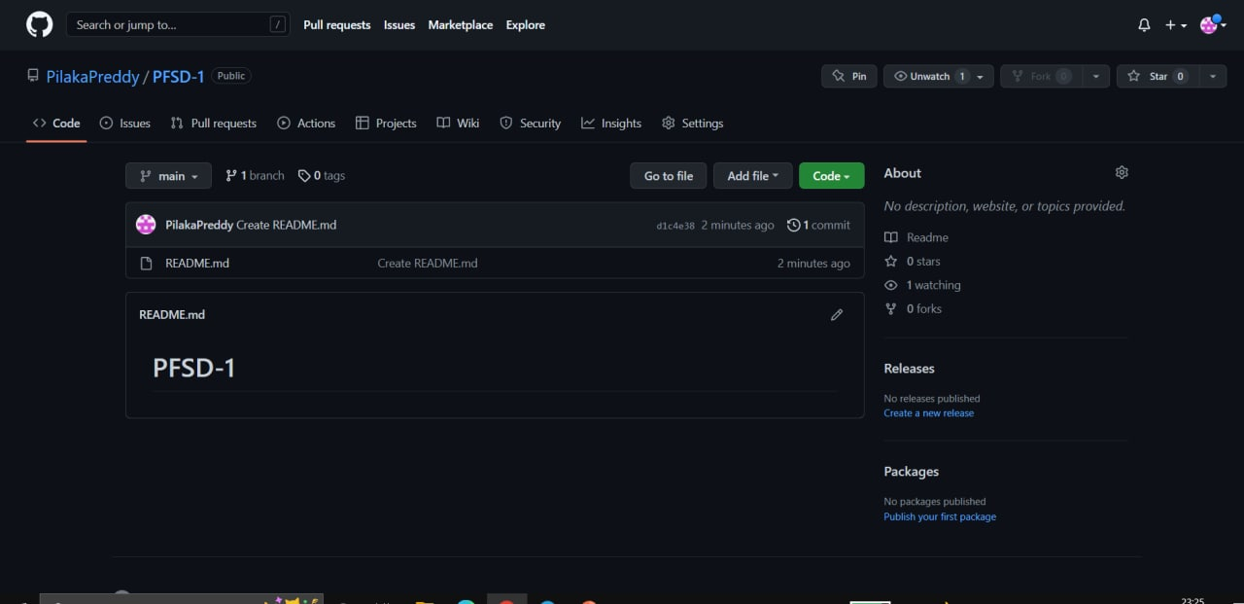
GITHUB REPOSITORY
https://github.com/PilakaPreddy/PFSD-1

Slide 6
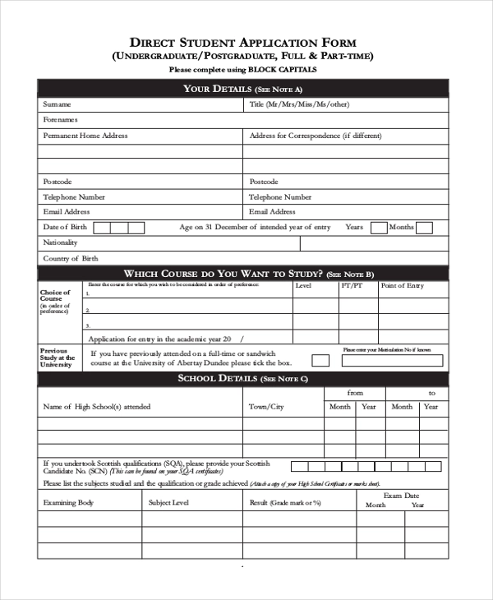
Dataset Collection
Student Name
Student Phone Number
Parent Details
Student Email
Program opted (B.Tech/MBA)
Course (CSE , ECE , AIDS)
Intermediate results

Slide 7
Tool Setup :
The tools required for the front end development process are :
Visual Studio Code
While the tools required for the backend development are :
MySQL
TerraER or StarUML ( For creating a diagram so as to model the project in a right way)

Slide 8
Work Allocation :
Name | Roll Number | Topic
P. Praneeth | 2110030028 | Backend development
B.Lakshmi Narasimham | 2110030001 | Backend development
T.Chandra Sekhar | 2110030138 | Front end development
P.Prithish | 2110030115 | Assisting for both front end and back end

Slide 9

Thank you!

